Slide 1
Investigating Current and Conductance Background Rhythms

Slide 2
GOAL
We have found before that steady injected current is not enough to elicit a nonlinear response from a dendrite. Currently, we have a noisy 50 Hz inhibitory conductance with a steady injected current to bring the cell to firing threshold, which has effectively elicited nonlinear response. We wish to characterize what part of the background rhythm gives rise to this nonlinearity. Is it the waveform of the conductance? Does inhibitory conductance need to be present? Can we recapitulate the waveform with a current injection to get the same response?

Slide 3
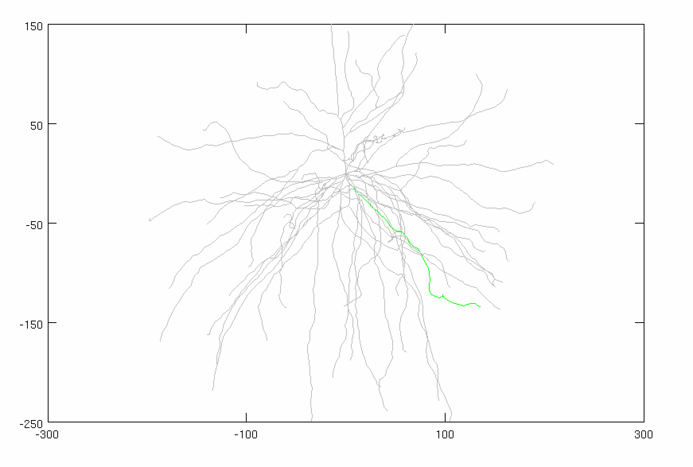
Parameters
Inhibitory Gamma
# Syns: 30 (ON SOMA)
Firing rate: 50 Hz
Distribution: 3 ms
Conductance: VARIABLE
Adjusted Current
Amplitude: VARIABLE
Noise: VARIABLE
Stimulus
Total synapses: 40 synapses
AMPA: 0.0015 µS
NMDA: 0.0039 µS
Firing rate: 50 Hz
Start Time: 5 ms
Noise: 0 ms
Location: 50% of the dendrite (focal, synchronized))
AVG: 15 trials
VARIABLE
VARIABLE
CONSTANT

Slide 4
Case 1: Control
Adjusted Current
Amplitude: 1.875 nA
Noise (Variance): 0 nA²
Inhibitory GABA
# of Syn: 30 (on SOMA)
Firing Rate: 50 Hz
Distribution: 3 ms
Conductance: 0.005 µS

Slide 5
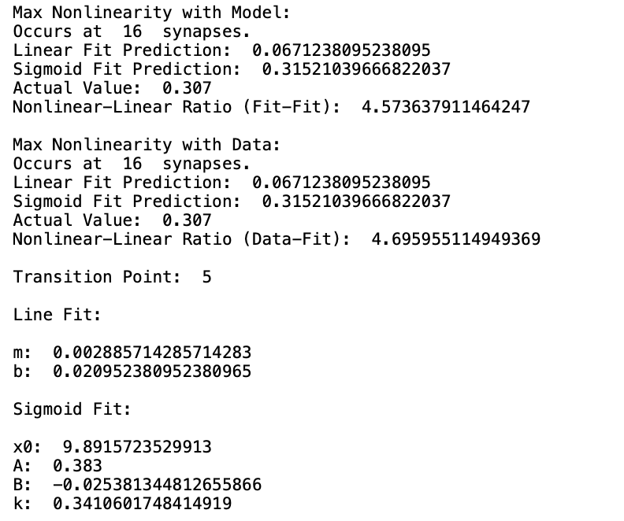
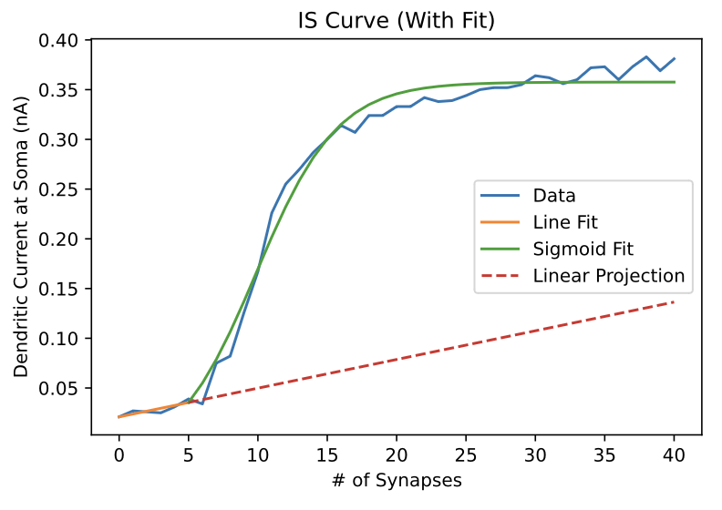
Case 1: Control

Slide 6
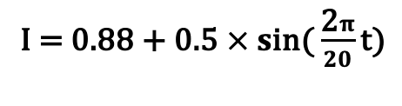
CASE 2: Sinusoidal Current (No Noise, No Inhibitory Conductance)
Adjusted Current
I = $\text{0.8}\text{8}\text{ + }\text{0.5 }× s\text{in}\text{(}\frac{\text{2}π}{20}\text{t}\text{)}$
Noise (Variance): 0 nA²
Inhibitory GABA
NONE

Slide 7
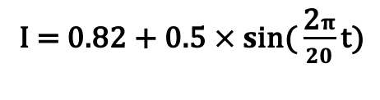
CASE 3: Sinusoidal Current (With Noise, No Inhibitory Conductance)
Adjusted Current
I = $\text{0.82 + }\text{0.5 }× s\text{in}\text{(}\frac{\text{2}π}{20}\text{t}\text{)}$
Noise (Variance): 0.5 nA²
Inhibitory GABA
NONE

Slide 8
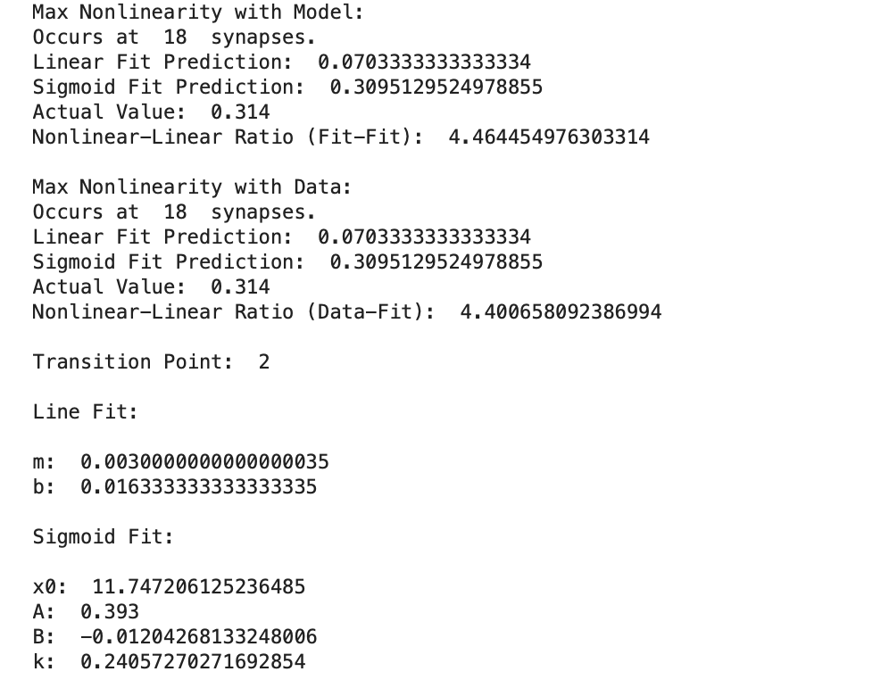
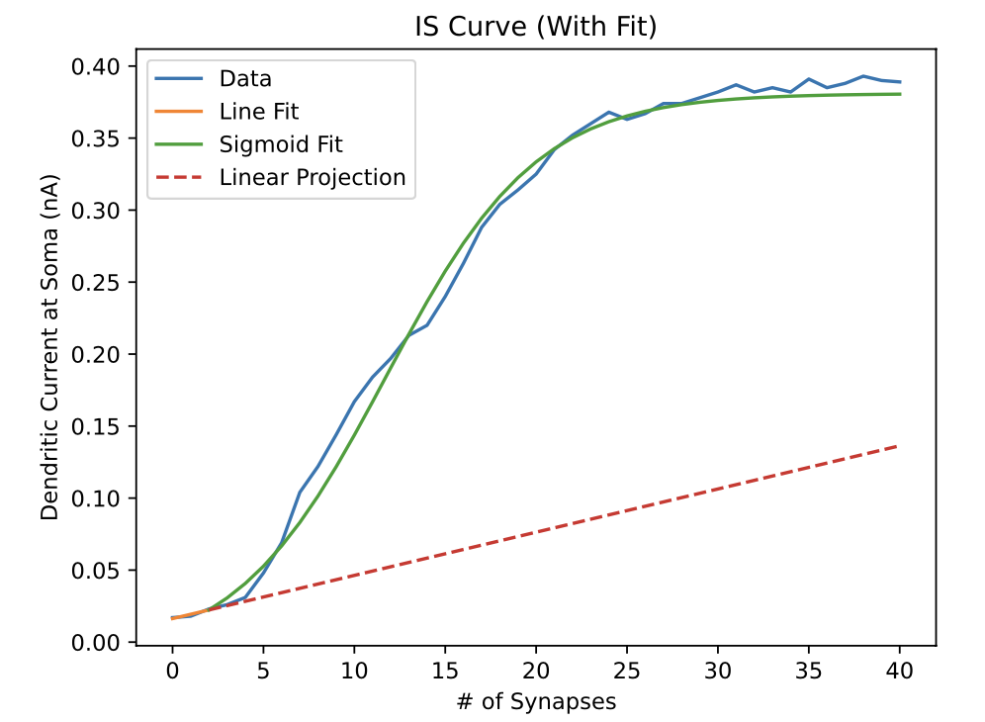
CASE 3: Sinusoidal Current (With Noise, No Inhibitory Conductance)

Slide 9
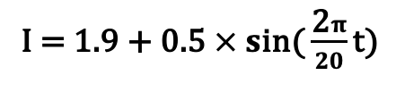
CASE 4: Sinusoidal Current (With Noise & Steady Inhibitory Conductance)
Adjusted Current
I = $\text{1}\text{.9}\text{ + }\text{0.5 }× s\text{in}\text{(}\frac{\text{2}π}{20}\text{t}\text{)}$
Inhibitory GABA
Conductance: 0.04 µS (attached to SOMA)
Steady Conductance (1 syn firing continuously)

Slide 10
CASE 4: Sinusoidal Current (With Noise & Steady Inhibitory Conductance)
Steady conductance brings cell to average membrane voltage of inhibitory conductance synapses

Slide 11
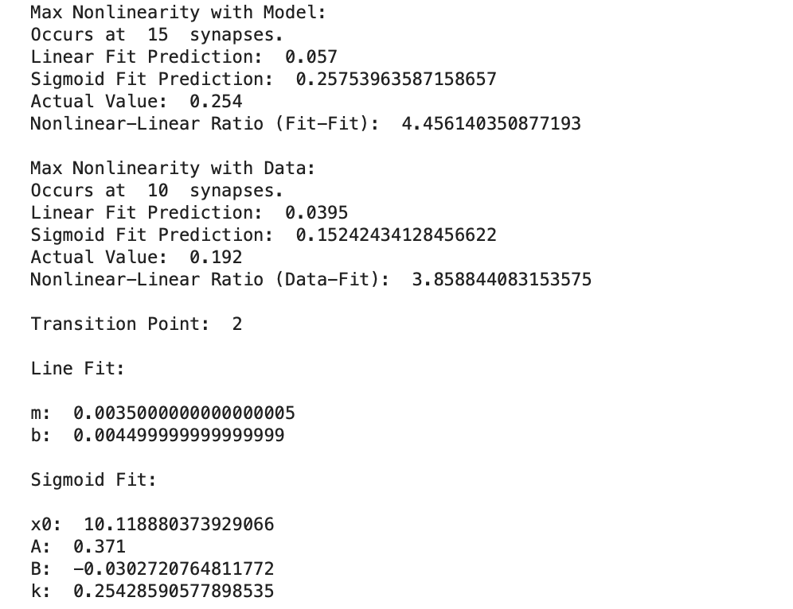
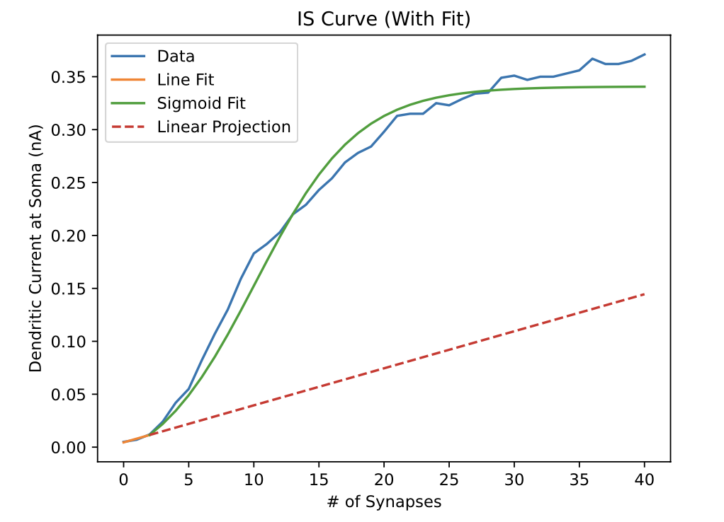
CASE 4: Sinusoidal Current (With Noise & Steady Inhibitory Conductance)

Slide 12
Compiled Cases

Slide 13
Compiled Cases

